Slide 1


Pedibus Development
Sponsored by Capital City Pedicab Company
In affiliation with the FSU and FAMU College of Engineering
Team 18:
Andrew Galan
John Hassler
James McCord
Onyewuchi Ebere
Sponsor: Instructor:
Ron Goldstein Dr. Kamal Amin
Faculty Advisors:
Dr. Chiang Shih
Dr. Patrick Hollis
James McCord

Slide 2
Background
The pedibus is a pedal-powered vehicle used for transportation that seats a variety number of passengers depending on size.
The idea was developed to provide as an eco-friendly traveling entertainment center to attract people of all ages and professions.
        Some models contain alcohol distribution consoles in the center.
Also referred to as the pedal crawler, pubcrawler, and party bike.
The pedibus has grown in popularity over the last five years.
James McCord

Slide 3
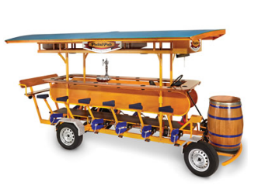
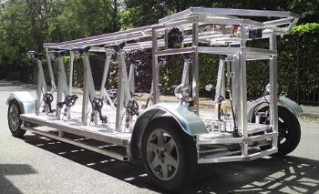
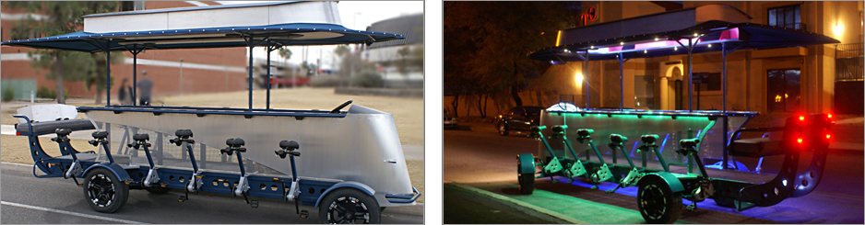
Existing Models
James McCord

Slide 4
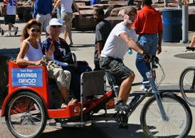
Sponsor
Ron Goldstein
Tallahassee Resident
Owner of Capitol City Pedicabs
Wants to manufacture the Pedibus for sale
James McCord

Slide 5
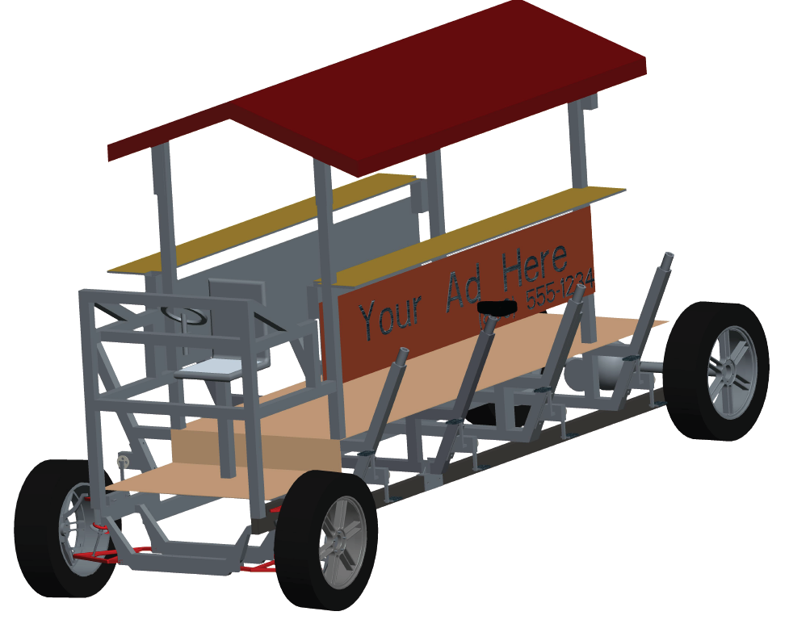
Final Design Selection
The Pedibus is broken down into three main components
        Structural frame
        Steering and braking
        Power transmission
James McCord

Slide 6
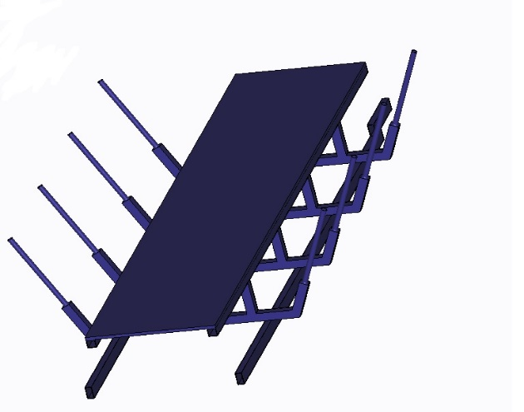
Aluminum and Steel
Initially we wanted to make a frame completely of Aluminum but after further analysis and modeling we concluded a mixture of the two would result in the most strength to weight ratio.
Using a minimalistic lower base of two steel rectangular beams to support the majority of the weight and an aluminum substructure above that.
James McCord

Slide 7
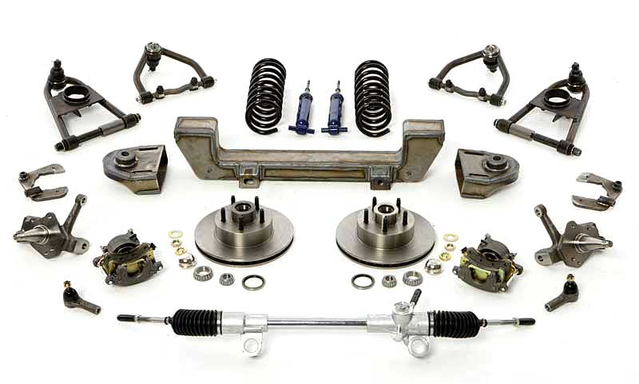
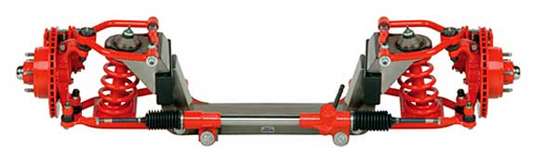
Front Axle
Decided on front end that included steering, braking, and suspension.
Chose Mustang II IFS for its light weight and simplicity
James McCord

Slide 8
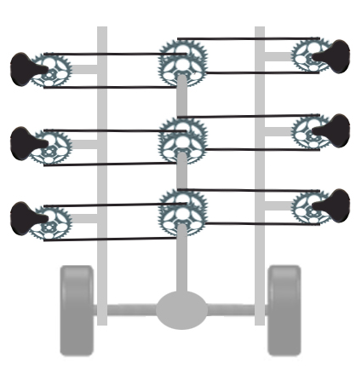
Drive Train Layout
Peddling input
Turns the drive shaft
Drive shaft turns rear differential
Differential turns the tires
James McCord

Slide 9
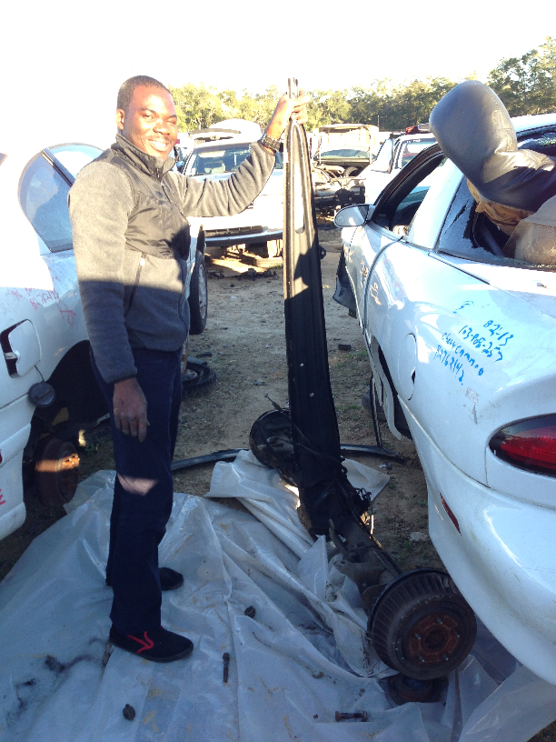
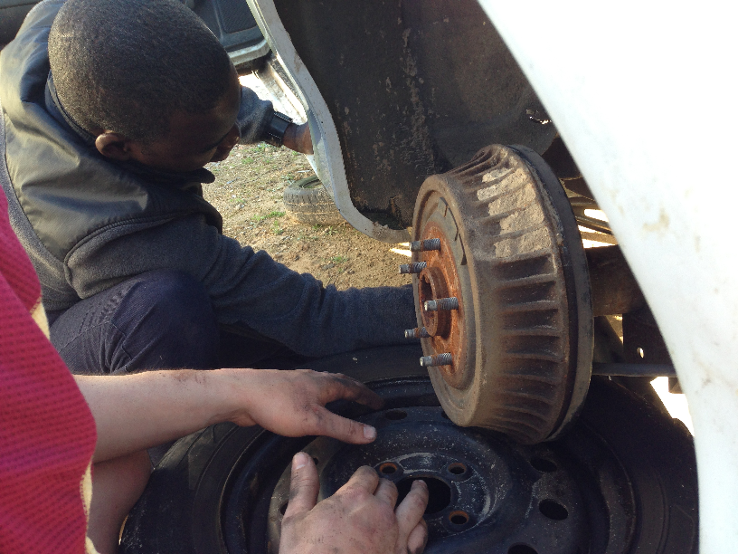
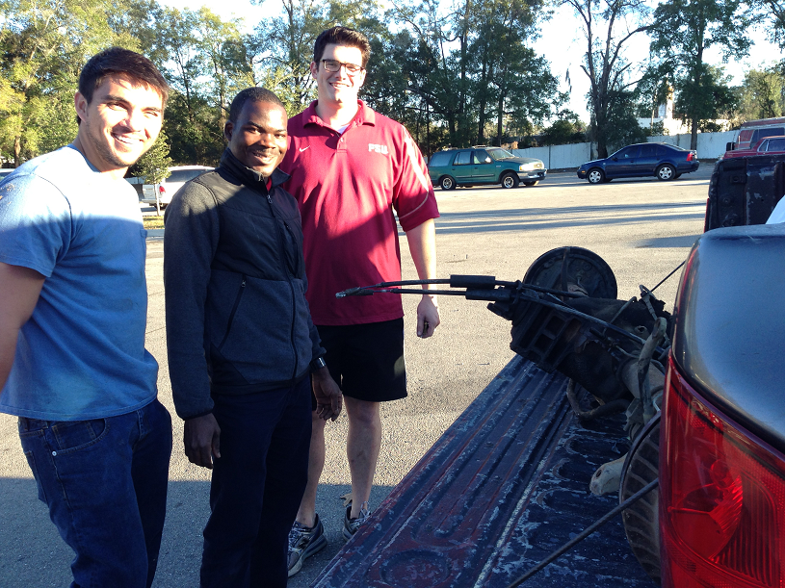
Progress this semester
Pulled the rear axle from 1992 Camaro from pick and pull
Gear ratio of 3.2:1 pick and pull
Used differential gear ratio to order bike parts
John Hassler

Slide 10
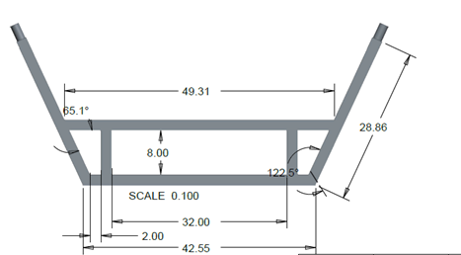
Progress this semester
Met with the sponsors auto mechanic
Ordered mustang II Independent front suspension
Used suspension dimensions to make design changes to the aluminum cross members
John Hassler

Slide 11
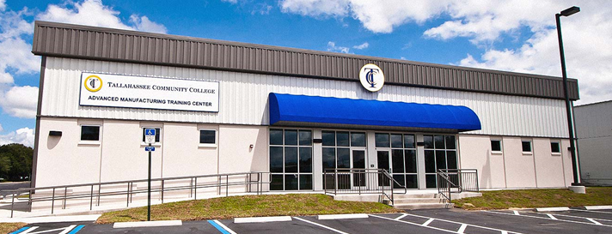

Storage and manufacturing space
We originally thought storage and build space was available through the sponsor
We were not aware we didn’t have build space until the beginning of this semester
Made contact with Bruce Batten the program manager for the advanced manufacturing facility at TCC
John Hassler

Slide 12
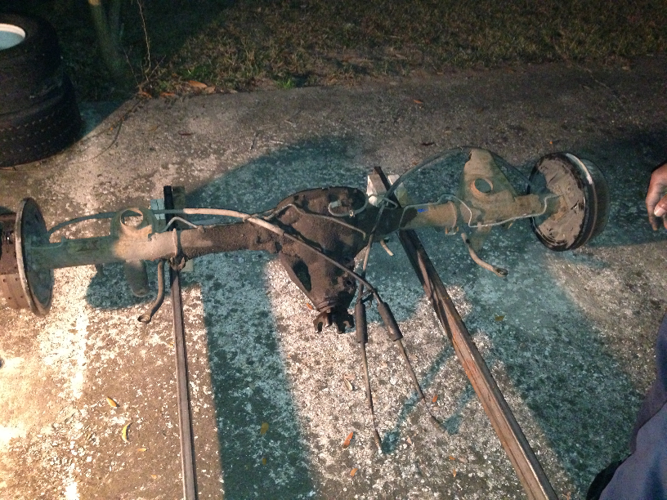
Initial assembly
Steel support spacing at rear axle is too narrow
Steel supports were redesigned to allow for wider spacing
John Hassler

Slide 13
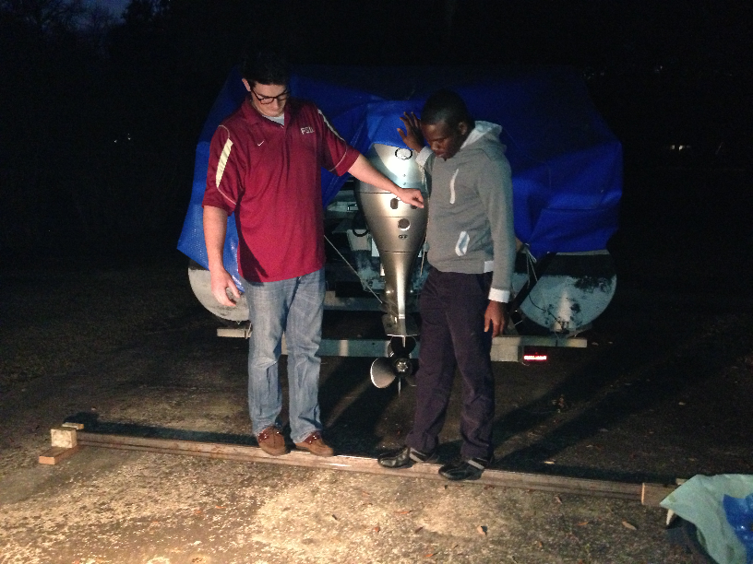
Stress Testing
1” by 3” steel rectangular tubing 1/8” thick looks bigger in 3d models than it does in reality
Bent slightly at the center between ¼” and ½”
Expected to be more rigid once the entire structural frame is assembled
If not rigid when fully assembled will weld tension rod across the bottom of the steel support
John Hassler

Slide 14
Changes To The Previous Design
The removal of power assistance mechanism
The redesign of the crank peddling station
Increase in the width of the chassis
Onyewuchi Ebere
Notes:
The removal of power assistance mechanism

Slide 15
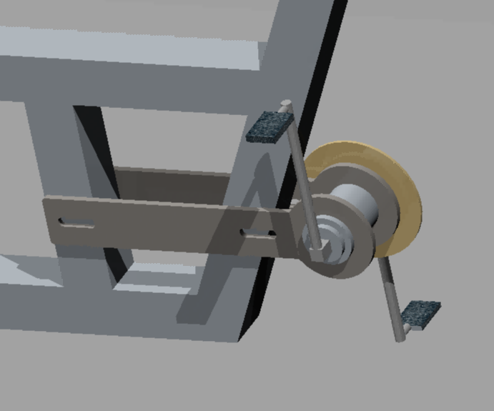
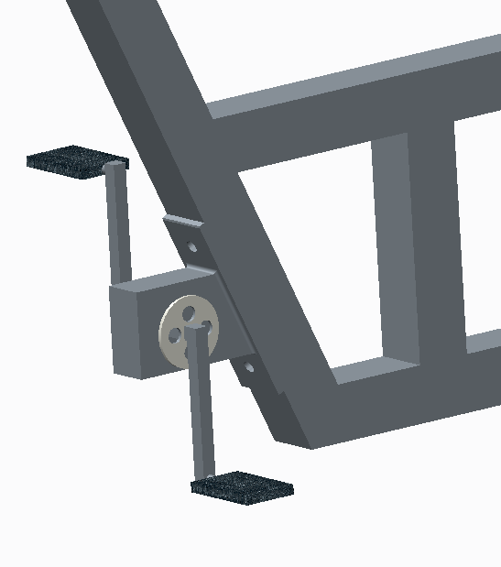
New pedaling station Crank Design
The new design incorporates a means to adjust chain tension as the chain stretches.
The chain tensions are independent.
The chain service life is prolonged
The chain that will be fitted need not be same seize as others
The new design
The initial design
Onyewuchi Ebere

Slide 16
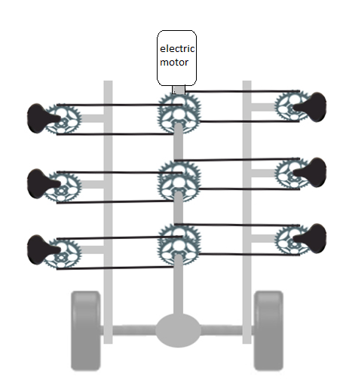
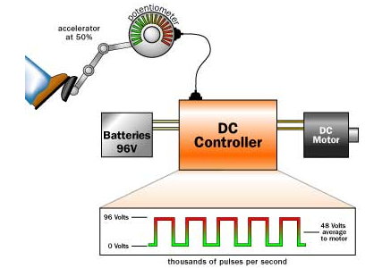
Removal Of Power Assistance
The cost to purchase the electric power assistance system given in the budget was very high.
The implementation will not favor the project time.
There is provision for the installation at a later date if need be.
Onyewuchi Ebere

Slide 17
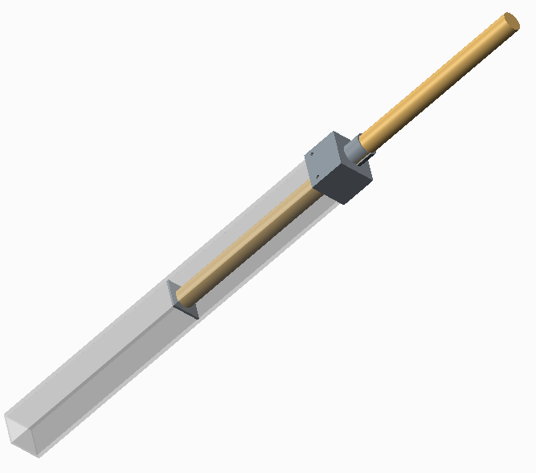
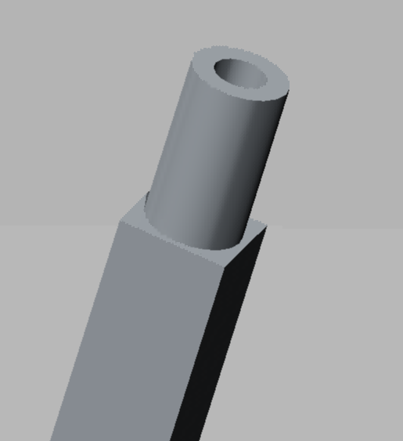
New seat post design
The new seat design
The original design induced excessive stress on the aluminum cross member
It was very difficult to achieve firm fitting since it does not have a collar
Does not give room for maximum adjustment without deflection
Seat post
collar
Aluminum cross member
The old design
Seat post held with set screw
Aluminum
cross member
Onyewuchi Ebere

Slide 18
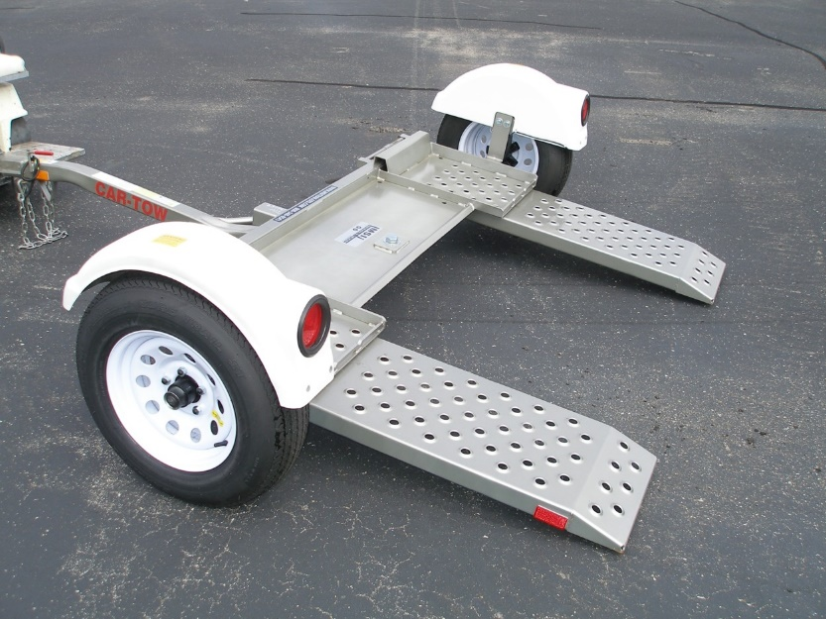
Moving Pedibus From Garage To The Sport Centers
  For the driver to be able to move the pedibus alone, we have included the housing for a dolly in the pedibus.
  Like a cart and other non self powered vehicles the pedibus can be carried with any car by simply using the dolly
DOLLY
Onyewuchi Ebere
Notes:
Without a power assist a driver will not be able to operate the vehicle alone, so the pedibus will need to be towed to the customer pickup location via a simple car dolly until a power assist is installed
In addition to time constraints, the cost of an effective Power assist system would add upwards of 3000$ to the total cost

Slide 19

Challenges encountered so far
The adverse weather due to the recent winter storm caused delay in shipping the independent front suspension we have ordered.
Based on the last tracking updates all the seven packages containing the Independent front suspension IFS have been shipped and will arrive within the week.
Sample of the assembled ordered IFS
Onyewuchi Ebere

Slide 20
Budget
BOM |  | # | Price Per Item
Steel Supports |  | 2 | $69.00 | $138.00
Aluminum Frame |  | 1 | $389.00 | $389.00
Pillow Blocks |  | 4 | $30.00 | $120.00
3/4 inch Cold Rolled Drive Shaft |  | 1 | $100.00 | $100.00
Mustang II Ifs |  | 1 | $1,350.00 | $1,350.00
Rear Axle and Differential |  | 1 | $140.00 | $140.00
Bike Crank |  | 8 | $45.00 | $360.00
Bike Seat |  | 8 | $17.00 | $136.00
Bike Chain |  | 8 | $30.00 | $240.00
Free Wheel gear |  | 8 | $25.00 | $200.00
Wheels |  | 4 | $104.00 | $416.00
Electric Motor & Controller |  | 1 | $880.00 | $880.00
Battery |  | 1 | $53.00 | $53.00
Lighting Kit |  | 1 | $170.00 | $170.00
total |  |  |  | $4,602.00
New total for metal = $475.00
New total for bike parts = $1,160.00
New total for pedibus = $3,707.00
Andrew Galan

Slide 21
In The Future
Expected to have access to building facility at TCC before the end of the week. As soon as we have access we will transfer all our parts to the build location.
When Front end arrives deliver it to mechanic for assembly
When aluminum cross members are completed we will begin assembling the structural frame and installing the drive shaft and bicycle components.
Andrew Galan

Slide 22
In The Future
Stretch goal of completing the pedibus by March 30 for spring time Tallahassee parade.
Must purchase parts for the roof.
  Several roof designs have been proposed but sponsor has not picked one
  All roofing materials can be sourced quickly locally
  Roof design is largely cosmetic and has little effect on the performance of the pedibus

Slide 23
Questions
?

